Slide 1



ONLINE FOOD DELIVERY APPLICATION
--- MANISHA C ---

Slide 2

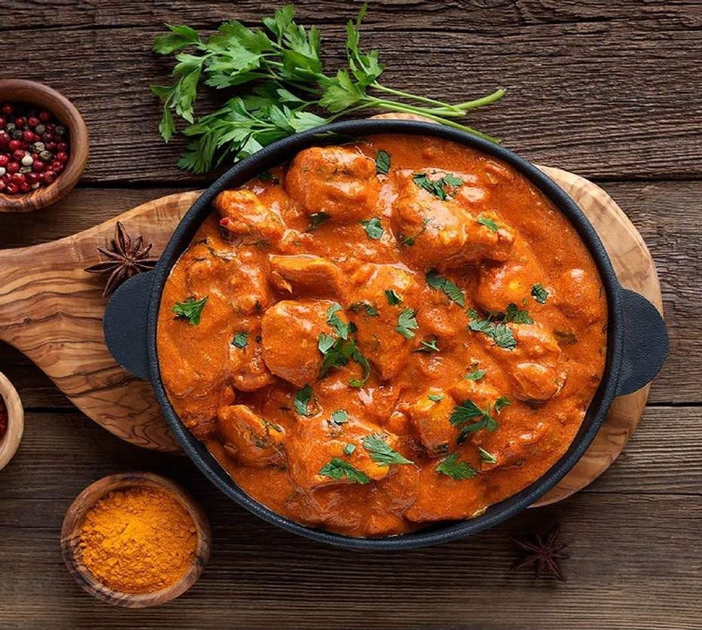
WELCOME FOODIES!!!
Have a delicious food that u have
Never tasted IT BEFORE!

Slide 3

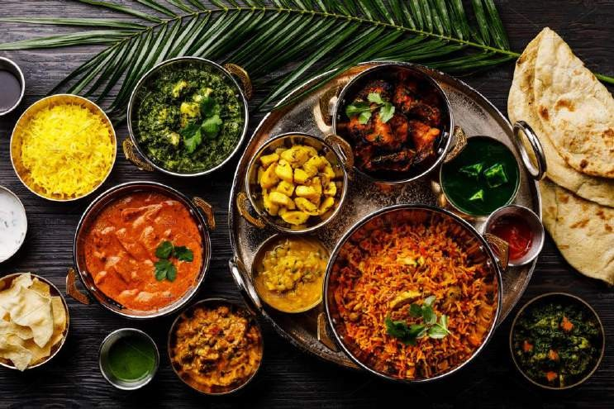
INTRODUCTION
Full Stack Application – Online Delivery application (FOODIE).
An Online Delivery application is an application that is designed to order the foods from our convenient place. It helps the users to get their favourite dishes at their convenient time and also very quickly since we provide fastest delivery. This is completely automated and you can order the food and get it soon.

Slide 4
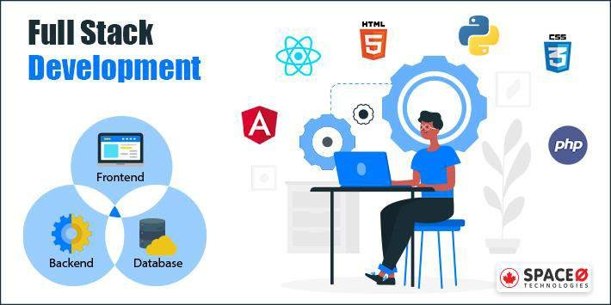

Slide 5

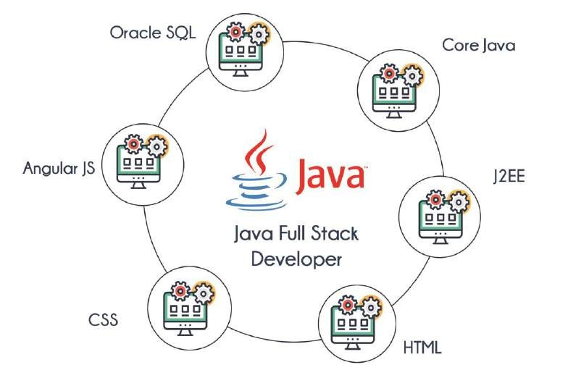


Technologies used
MySQL

Slide 6






The Architecture of the Project
Frontend
Backend
Node JS
MySQL
Angular JS
Spring Boot

Slide 7
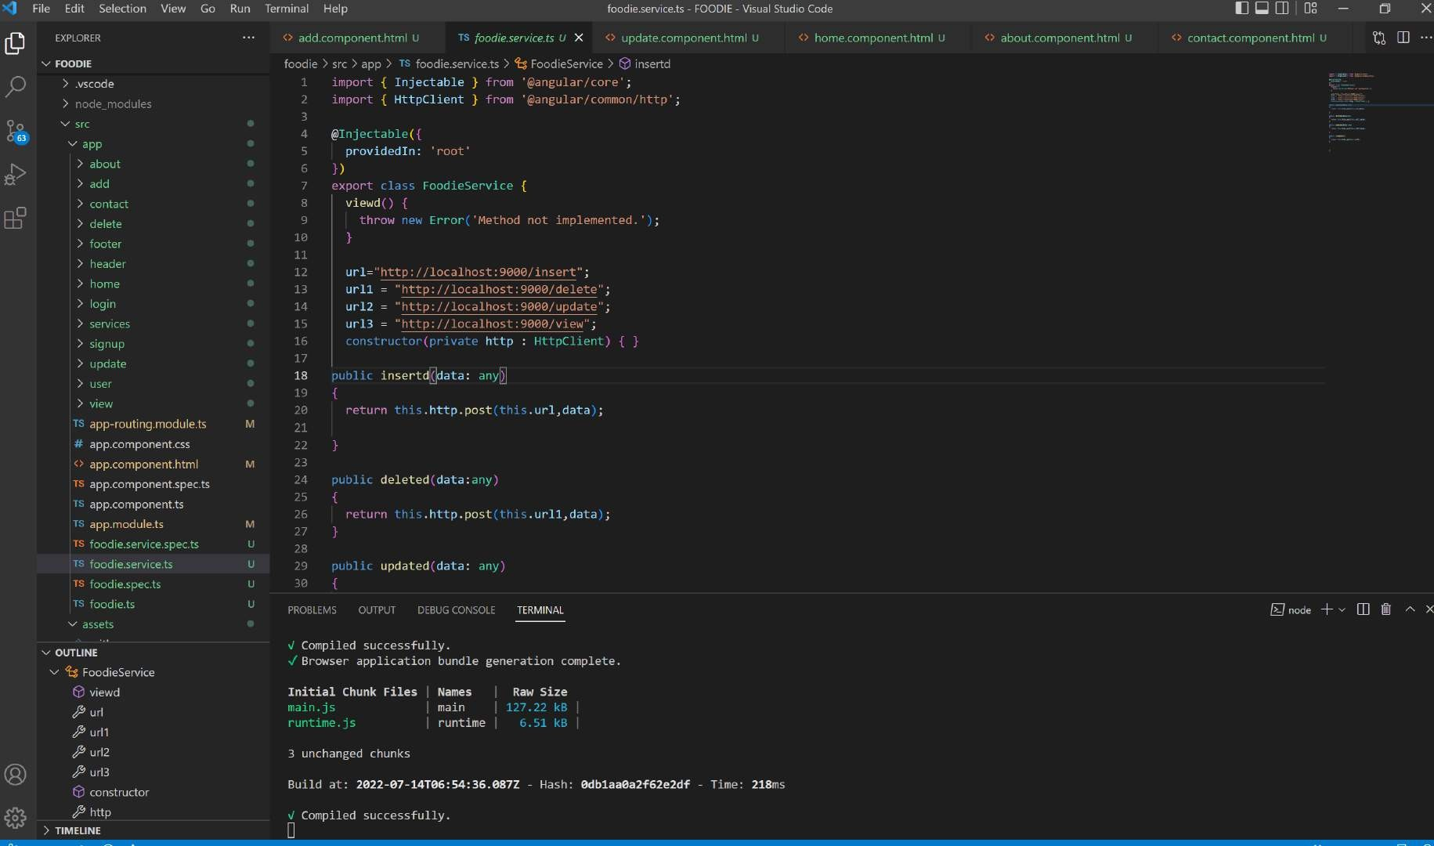

Slide 8
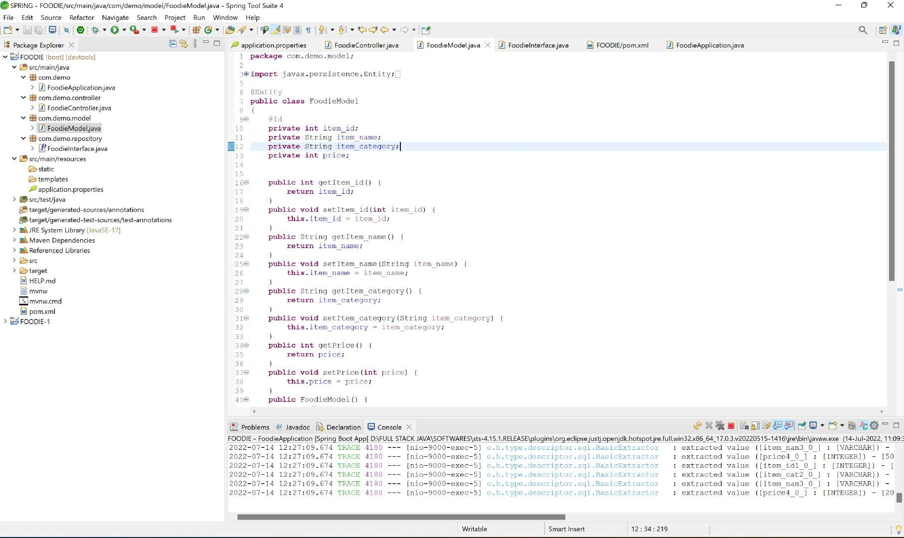

Slide 9
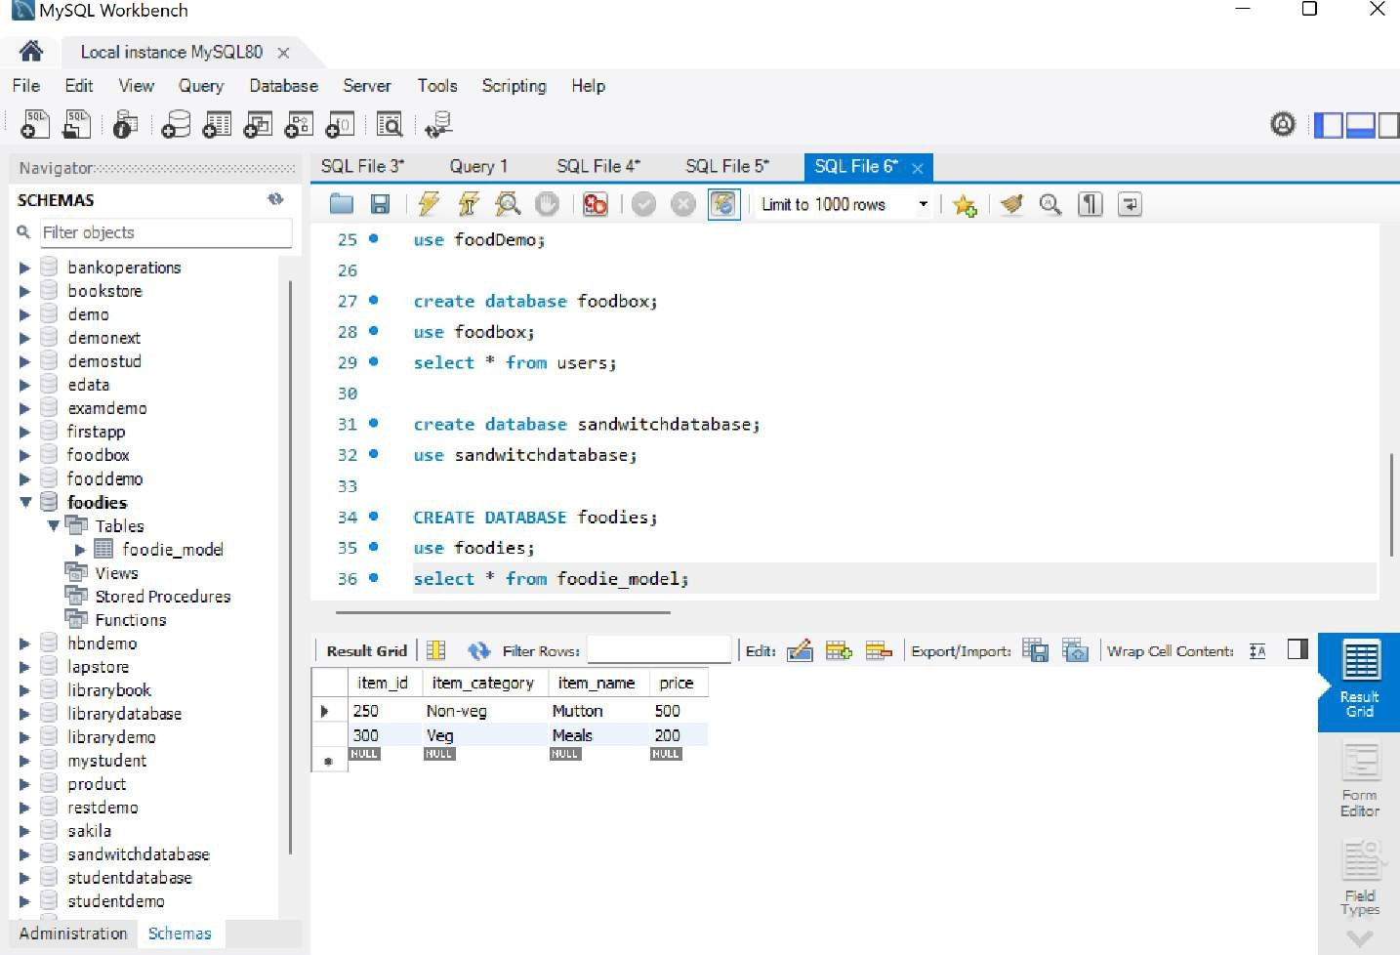

Slide 10
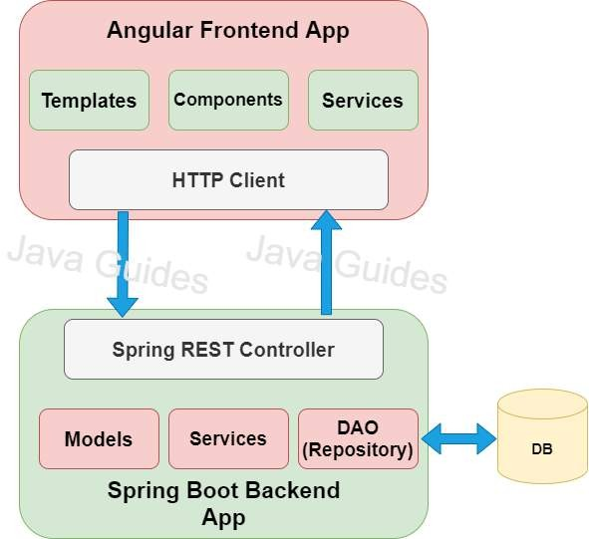
FLOW OF ANGULAR AND
SPRING

Slide 11
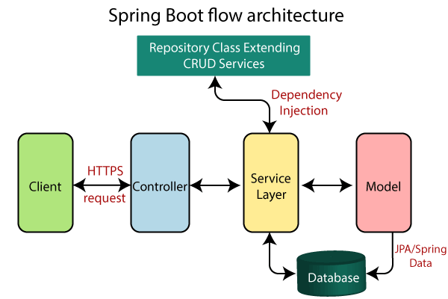
SPRING FLOW

Slide 12
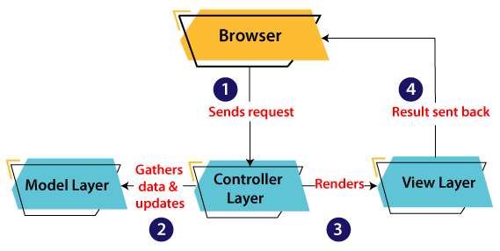
MVC ARCHITECTURE

Slide 13
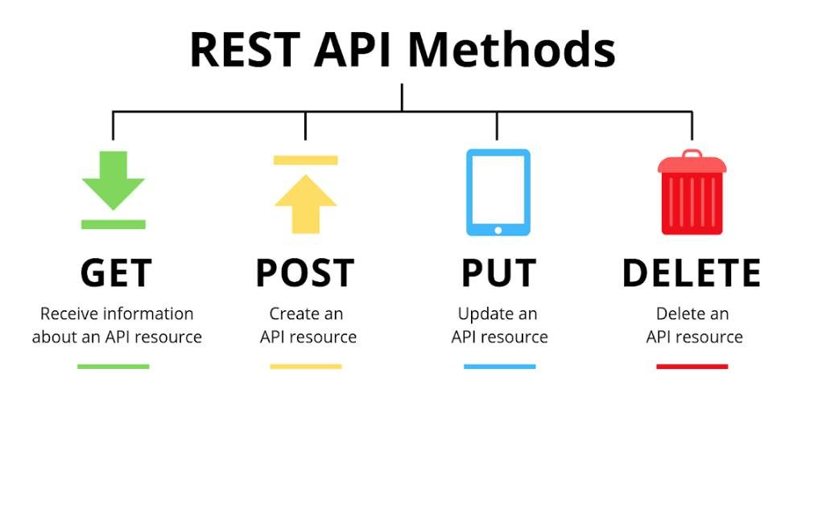

Slide 14
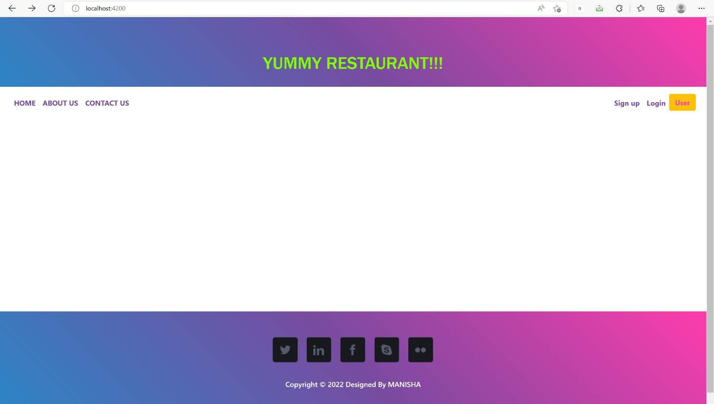

Slide 15
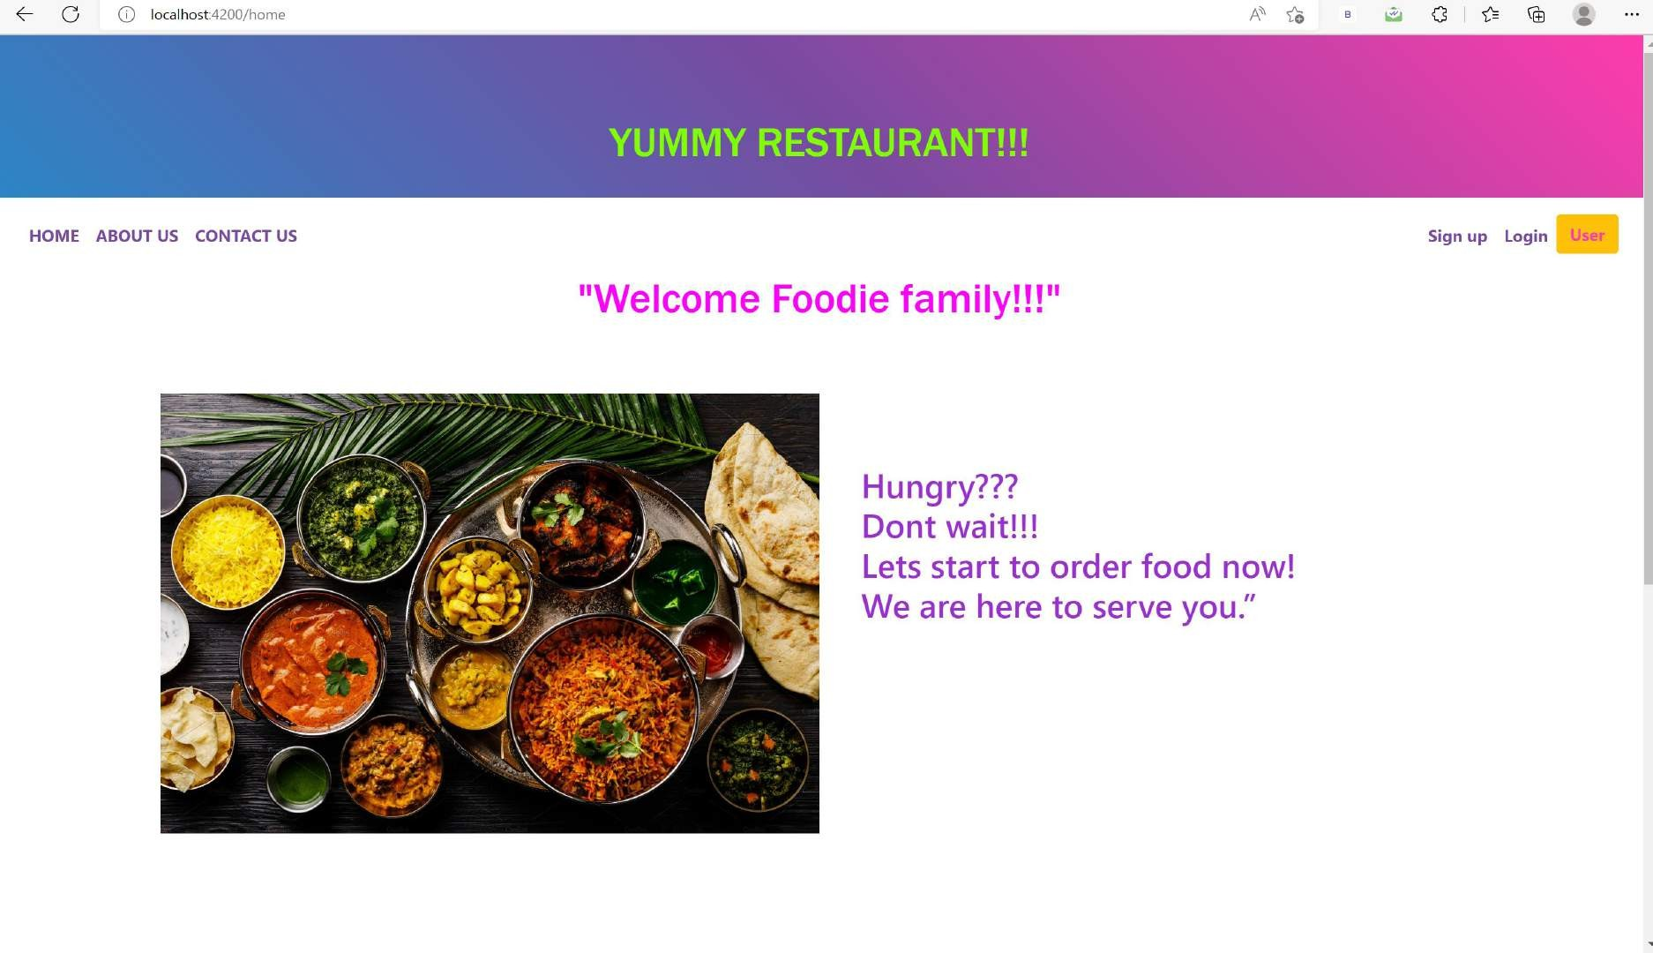

Slide 16
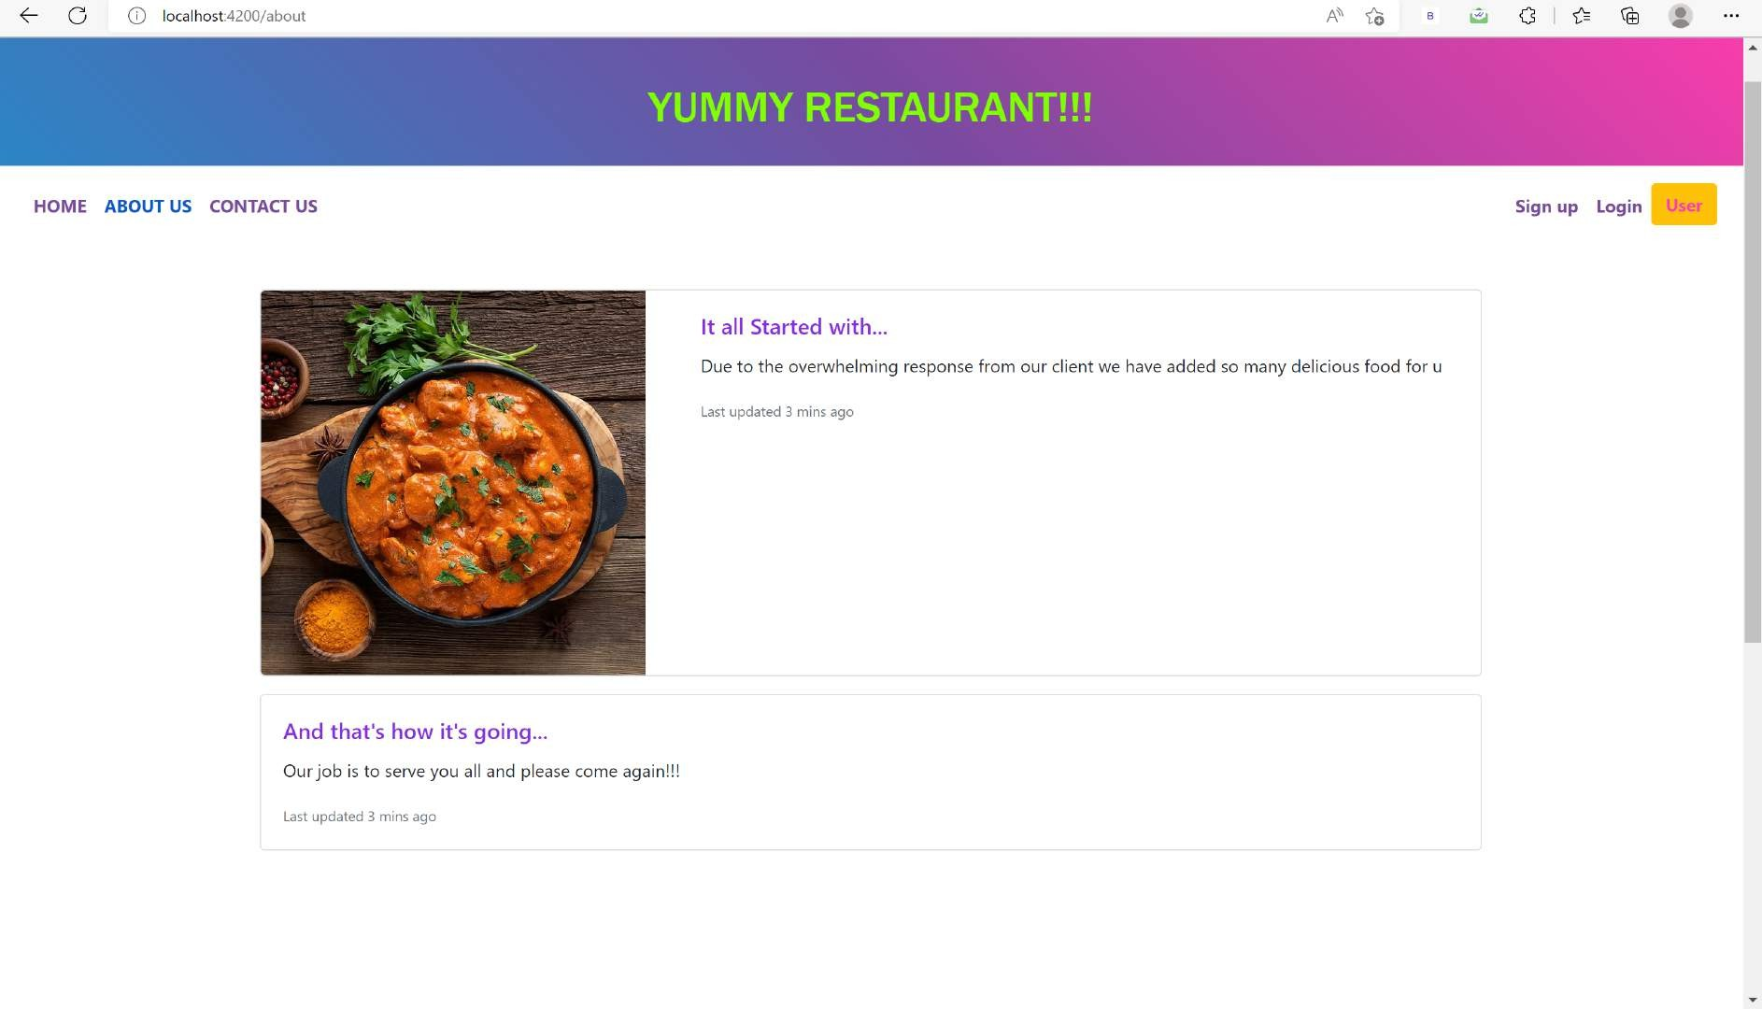

Slide 17
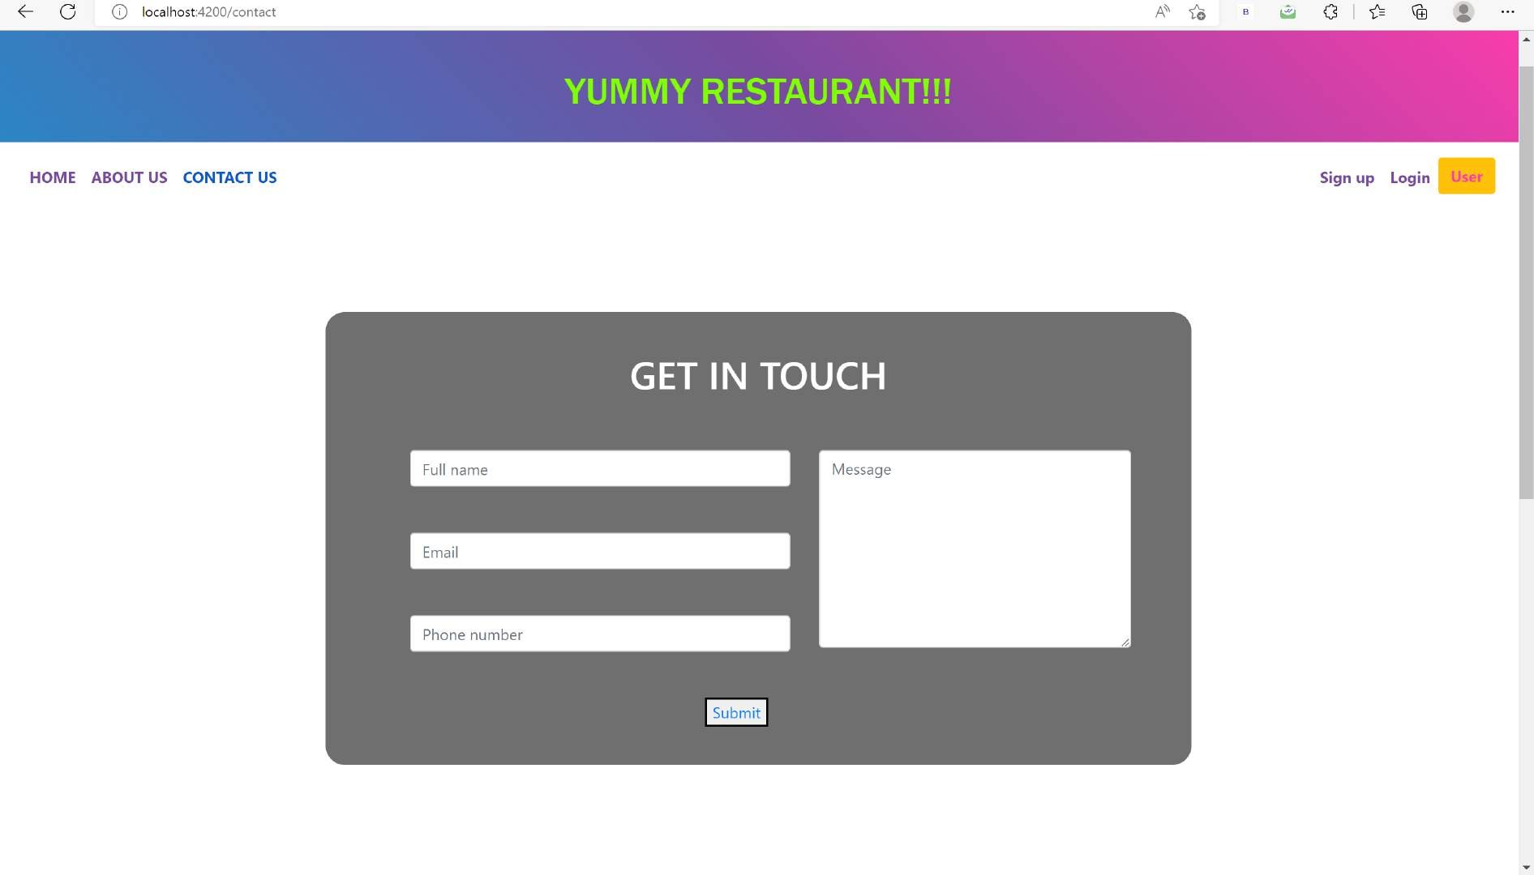

Slide 18
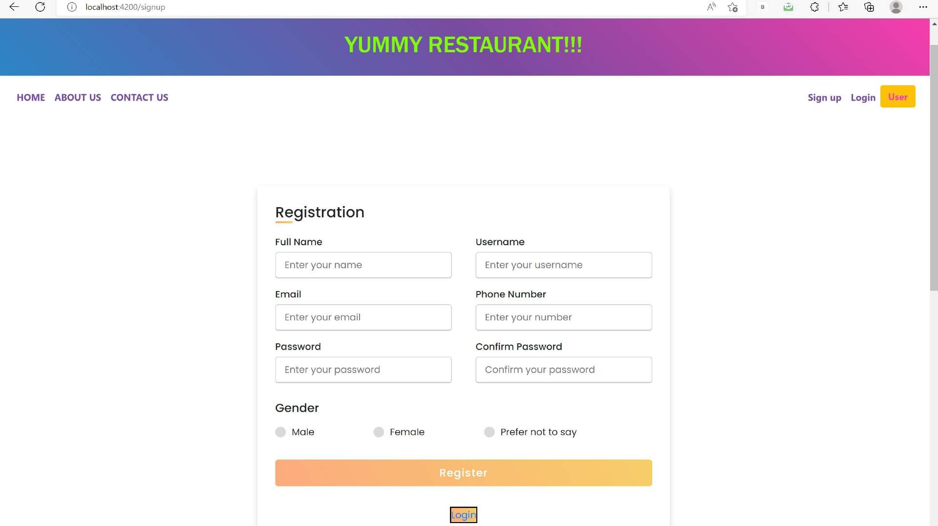

Slide 19
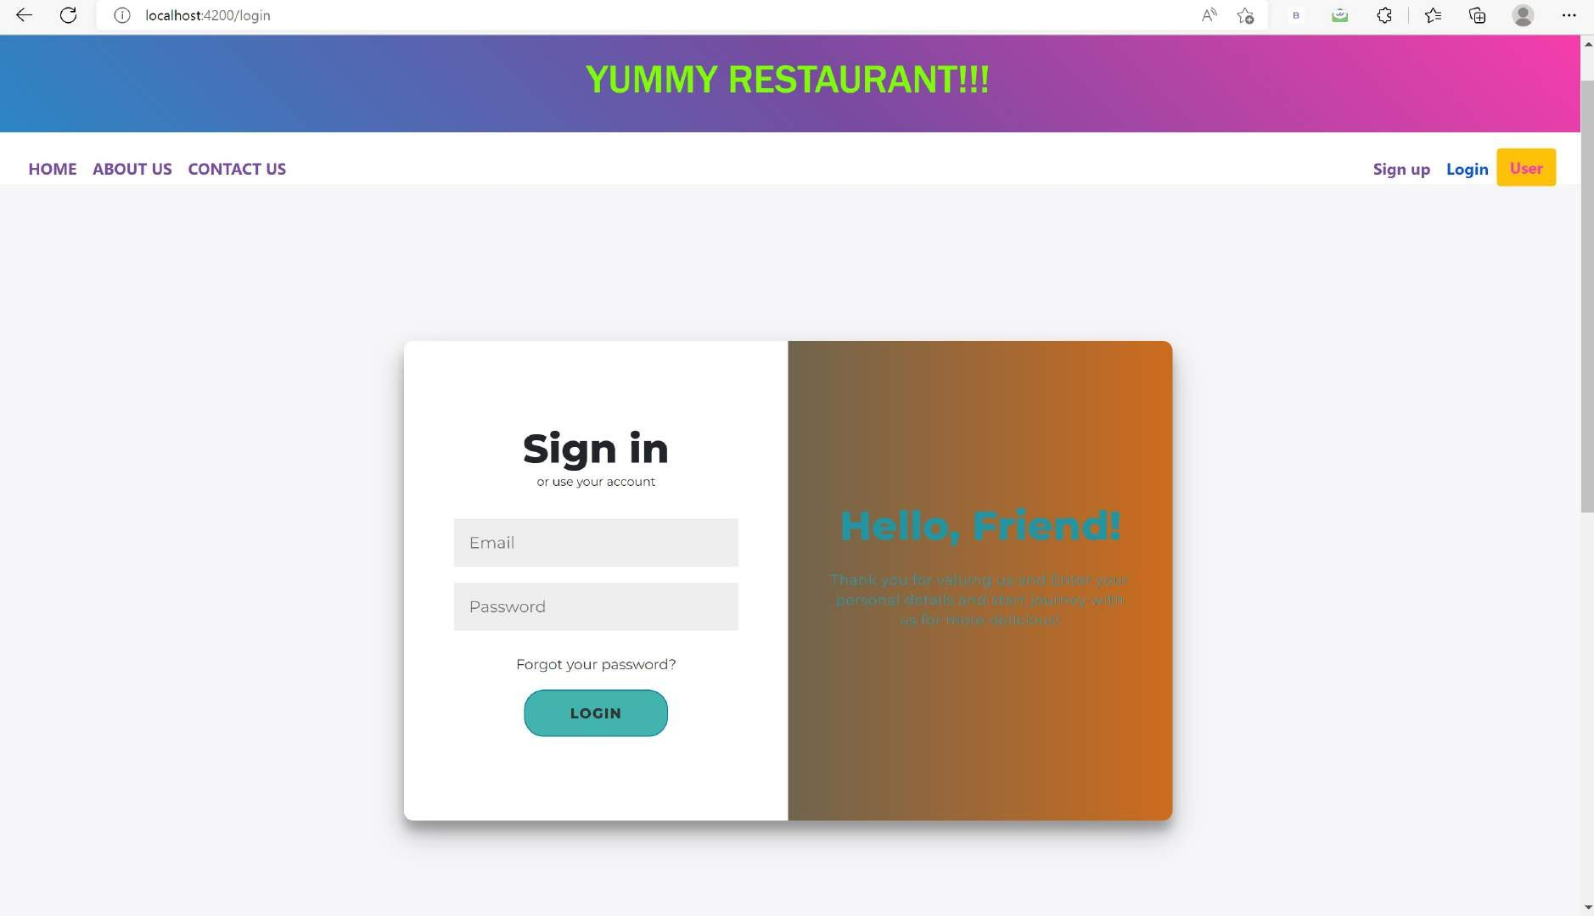

Slide 20
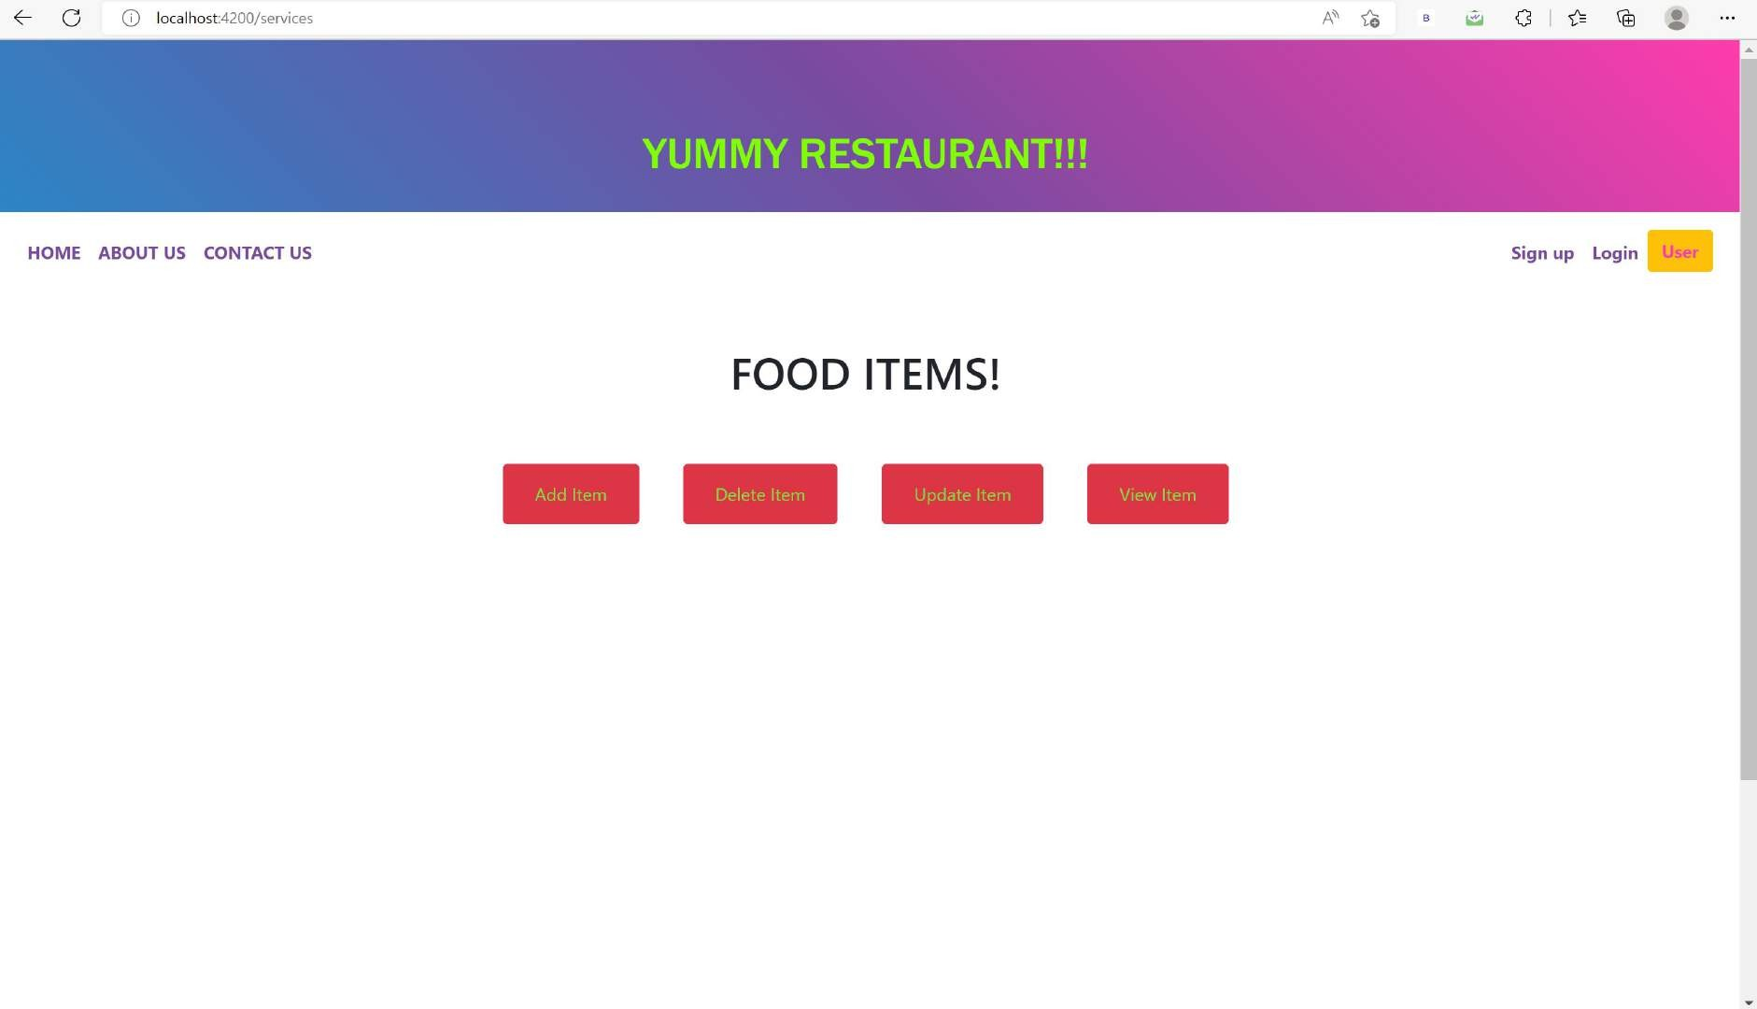

Slide 21
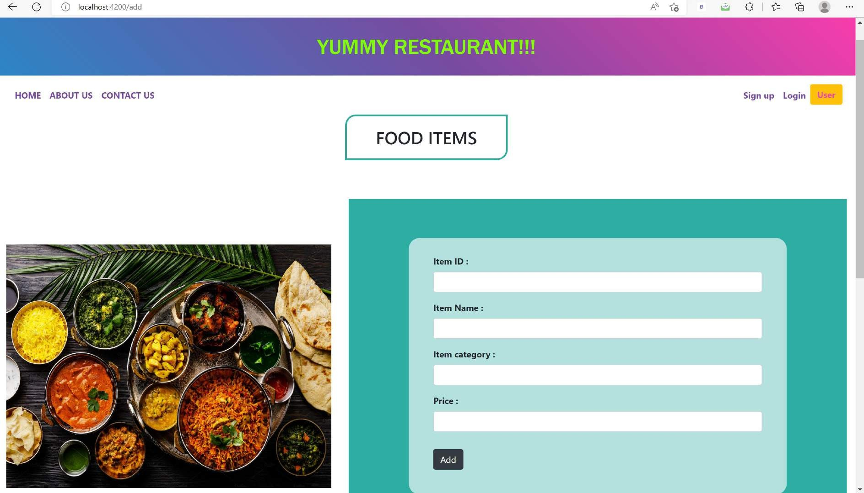

Slide 22
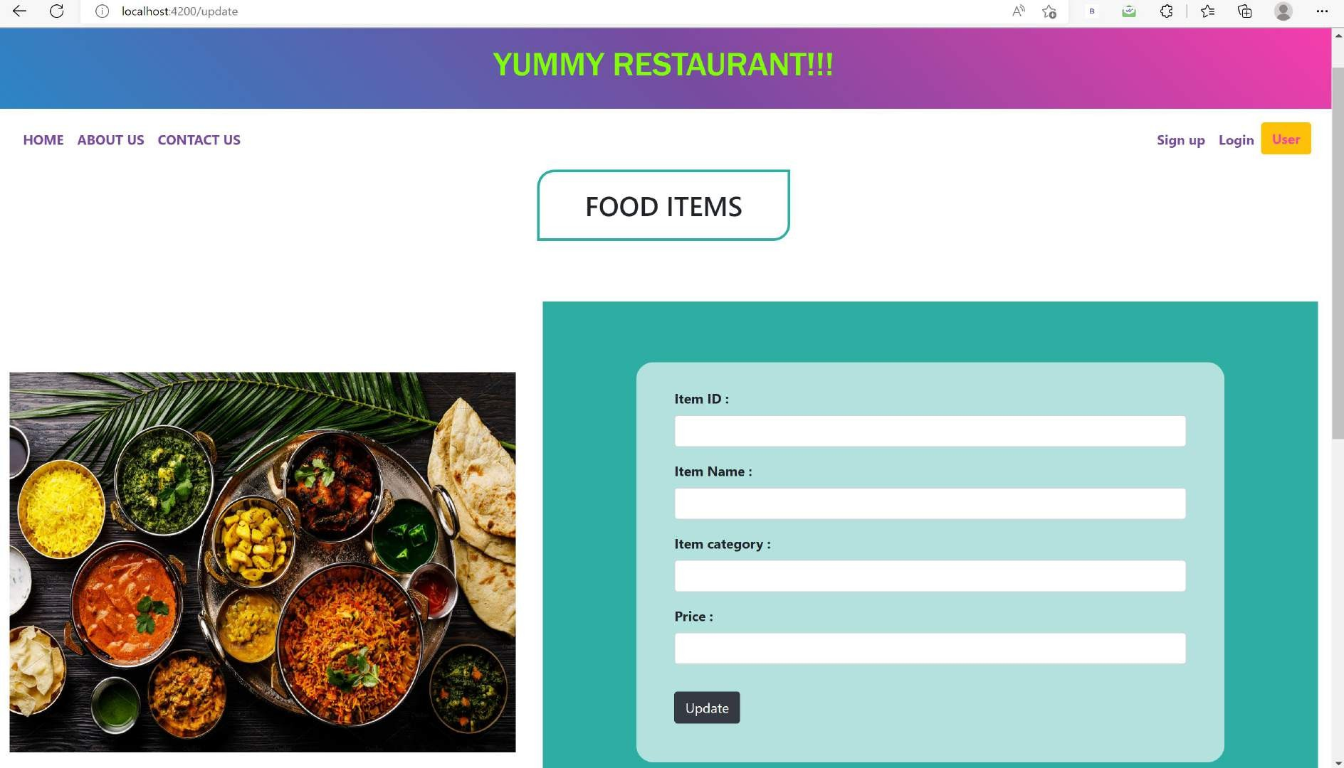

Slide 23
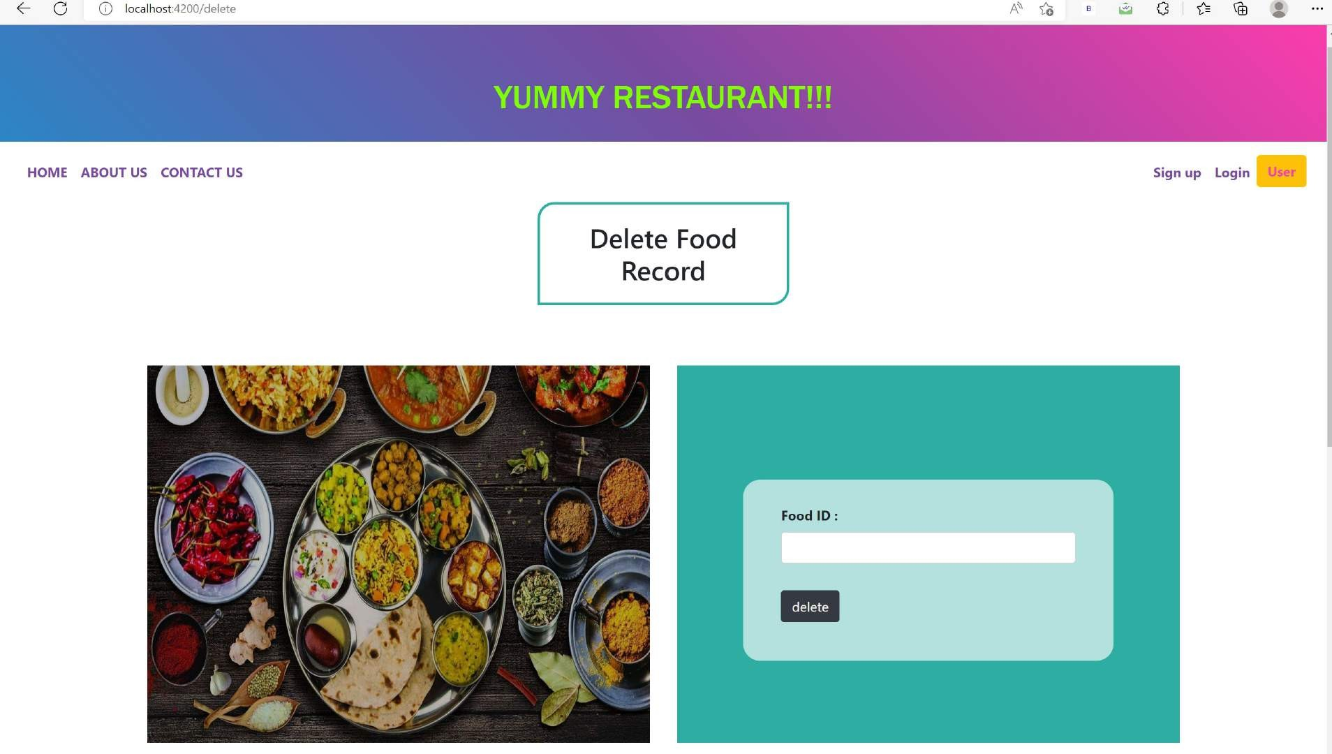

Slide 24
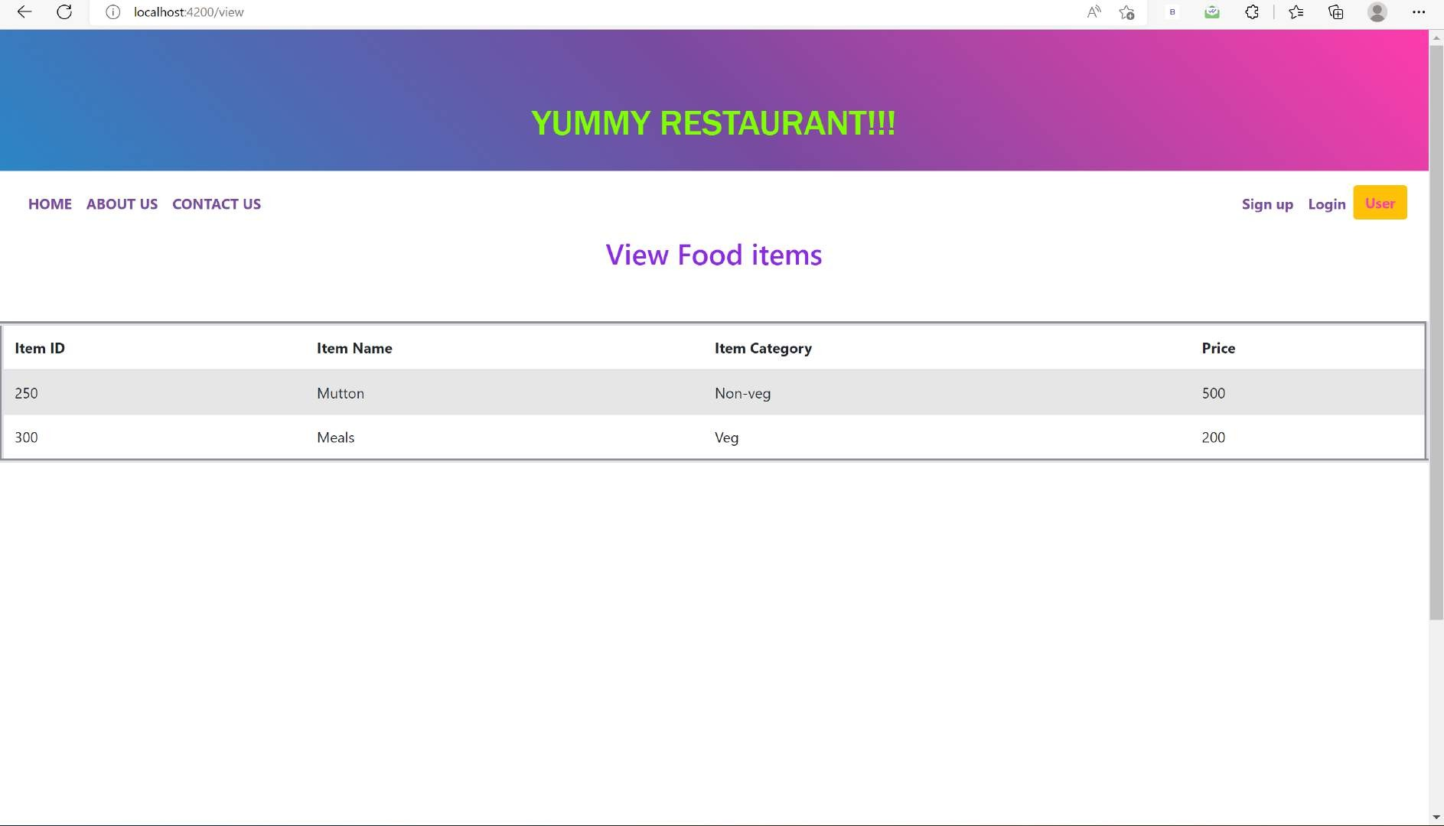

Slide 25
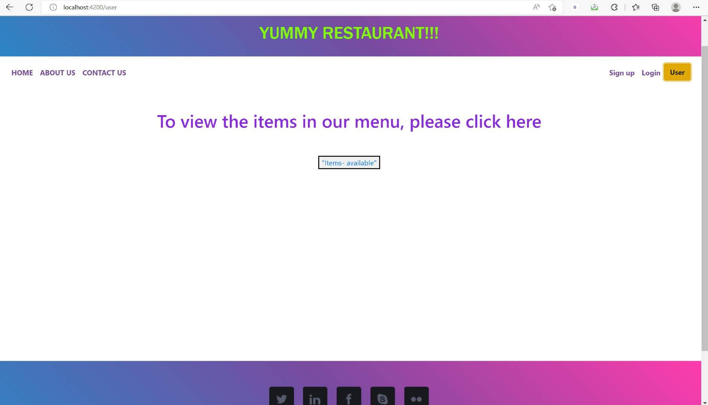

Slide 26
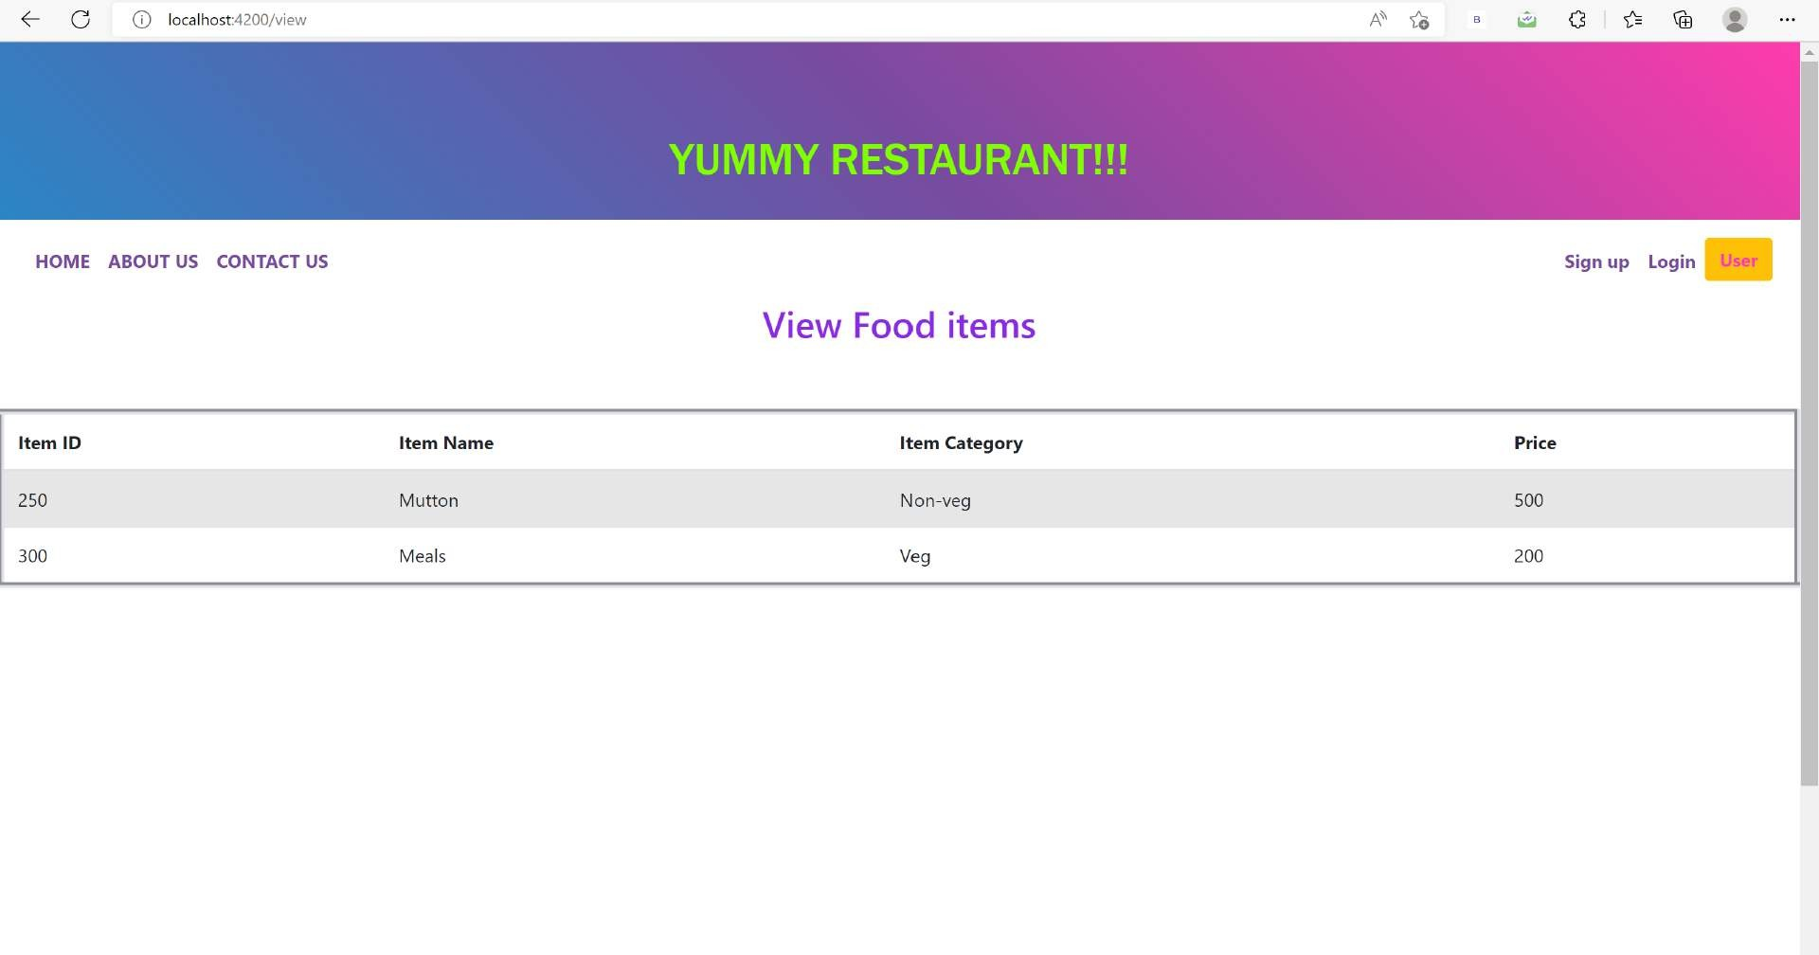

Slide 27
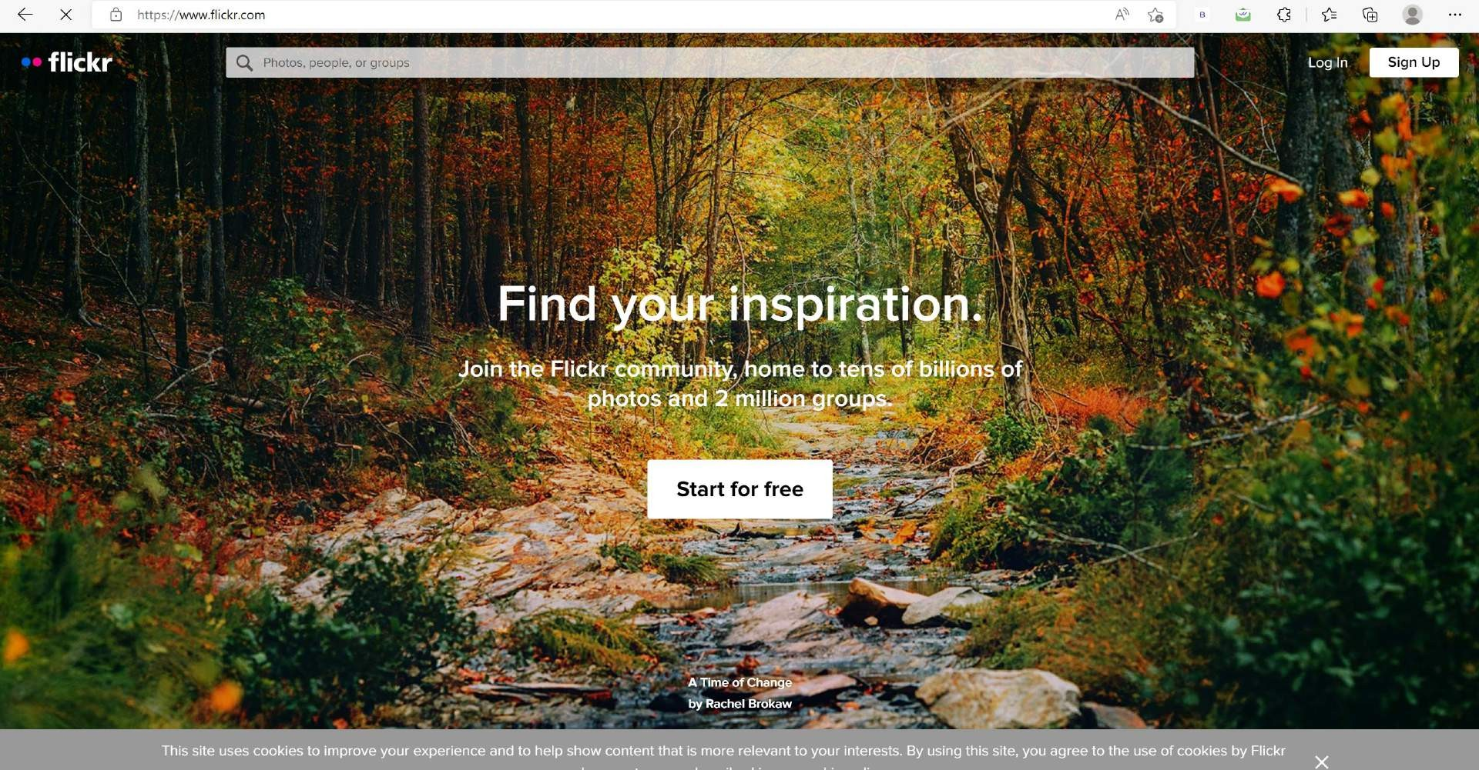

Slide 28
GITHUB LINK
Manishachandran/FINAL-PROJECT (github.com)

Slide 29

THANK YOU!!!

